Slide 1
Week 3 : Master UFO Program &
Base 10 7Strong

Slide 2
What is Master UFO Program?
Is a structured system that identifies and quantifies what successful Market America Independent UnFranchise Owners (UFOs) are doing or have done to be successful with the business plan.
This is a follow through of Basic 5 #3 Retailing & #4 Prospecting , Recruiting and Sponsoring.
Focus on Result Producing Activities (RPA)
This program allows UFOs to enter into action with BELIEF and CONFIDENCE

Slide 3
In the UnFranchise Business, you can be :-
★ Sales representative
★ UnFranchiseTM Owner (UFO)
★ Master UnFranchiseTM Owner

Slide 4
What is a Master UFO?
A Master UnFranchise Owner is a qualified and active Independent UnFranchise Owner (UFO) who has made the commitment to master the UnFranchise Business Development System by implementing the established tasks, activities, and practices as set forth and defined in the Master UFO Program

Slide 5
Master UFO Program
Success Path

Slide 6
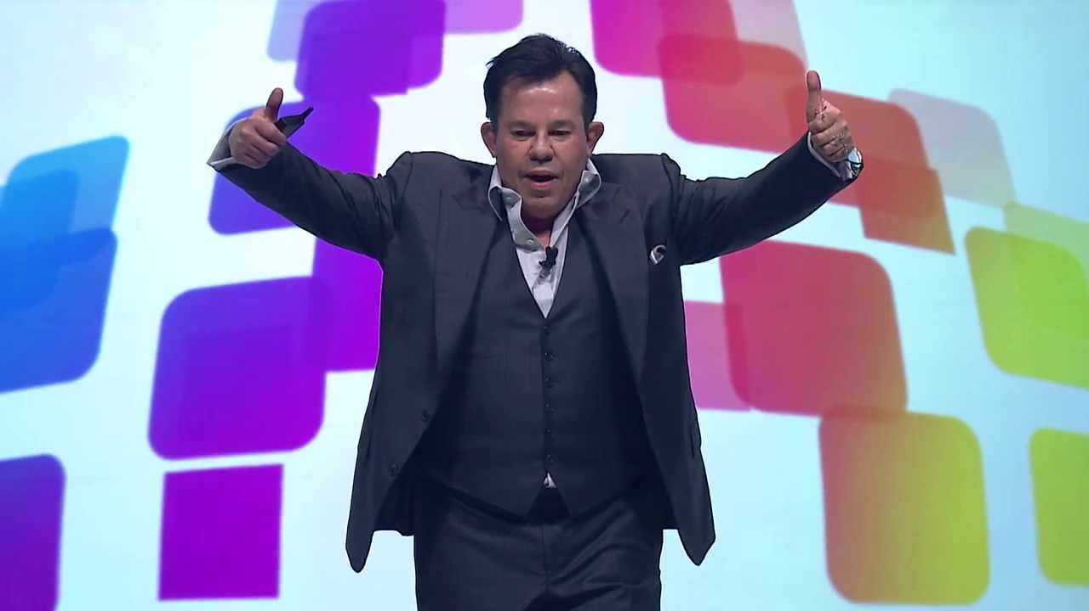
What is market America Culture?

Slide 7
The Essence of the UFO Program
“Everyone is looking for the keys to success. When I was a Distributor, I didn't care what it took or how hard I had to work. I just wanted to know exactly what I had to do to be successful. I didn't want to learn by trial and error or work hard and not make it. I wanted to know if I did certain things, I would make it.
The UFO program clearly defines what you must do to become an accomplished UnFranchise Owner — a true professional.”
JR Ridinger President and CEO

Slide 8
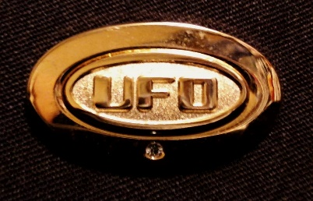
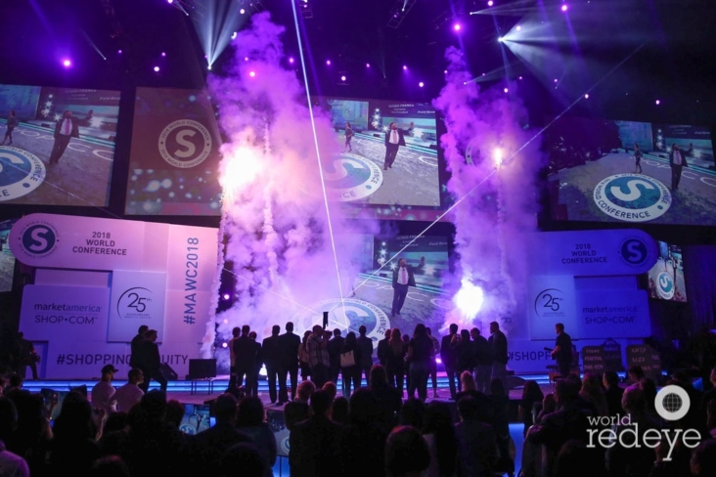
3 mths SYSTEM
World Conference
& International Convention
6 mths SYSTEM
Master UFO
Lets Get Started Right
SAMM

Slide 9
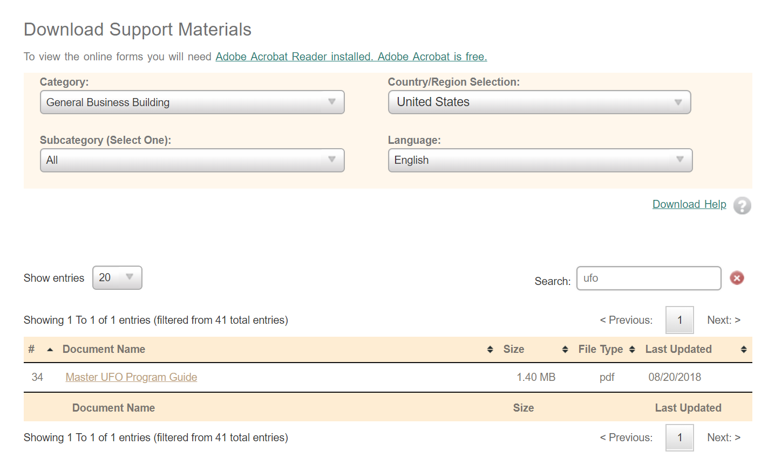
Where to locate it: unFranchise.com
Download the Programe Guide under

Slide 10
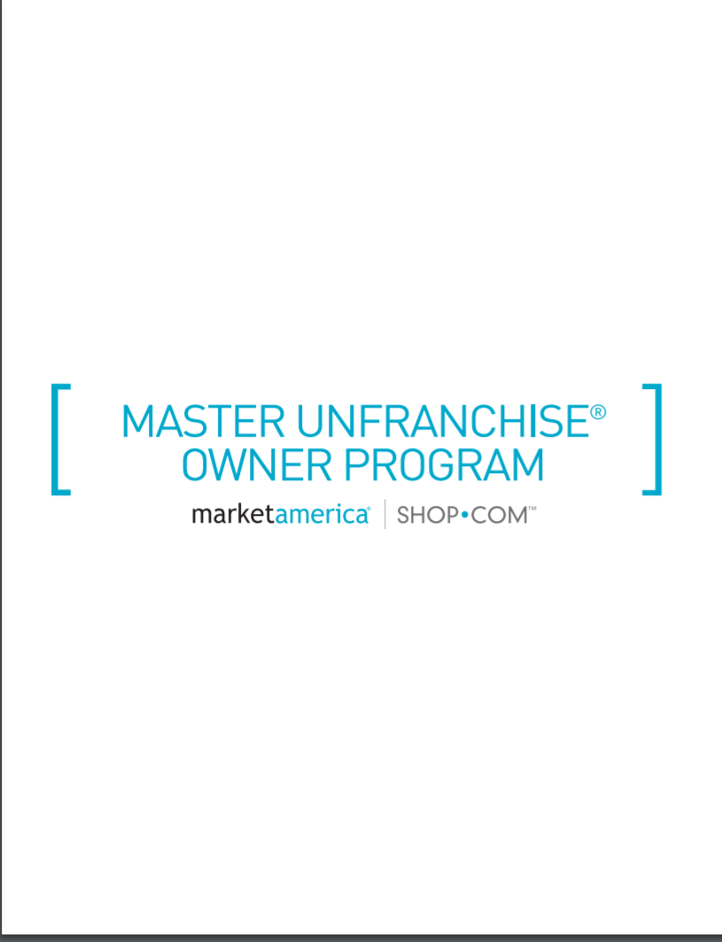
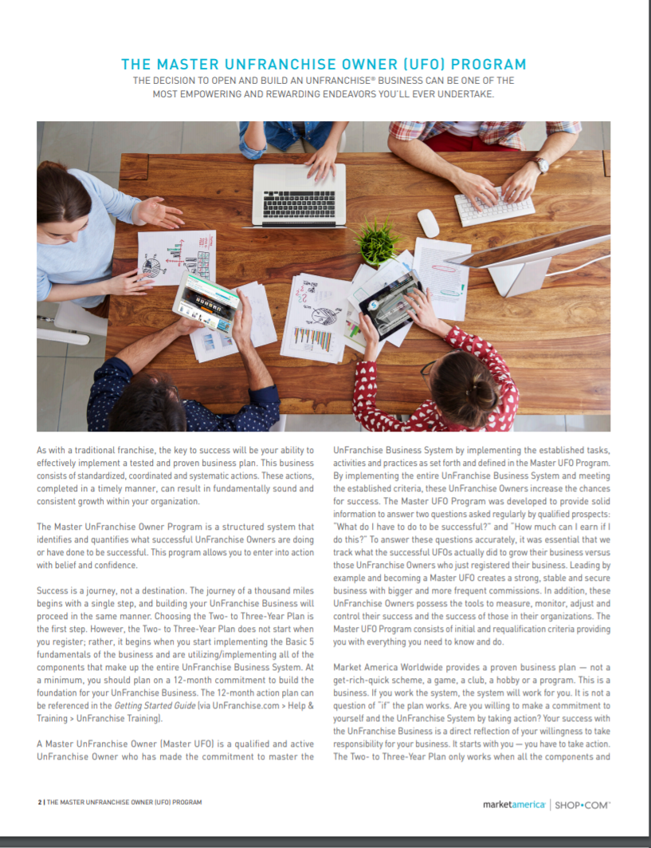

Slide 11
Criteria

Slide 12
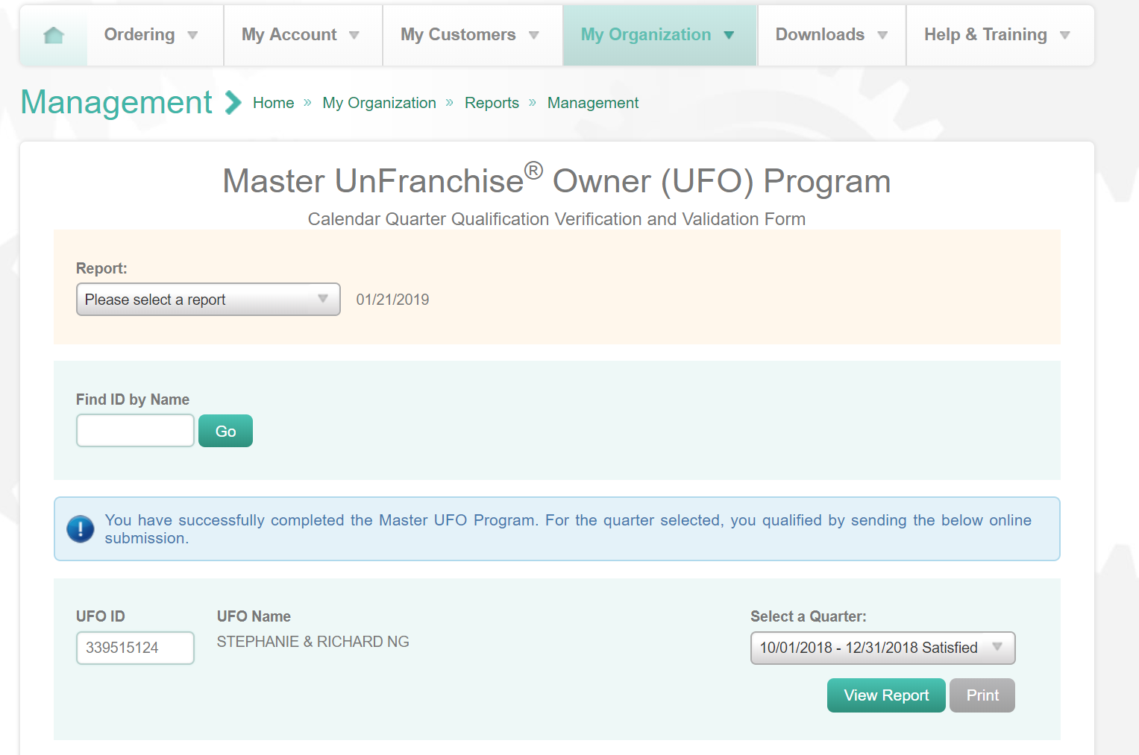
Where to monitor Progress? unFranchise.com

Slide 13
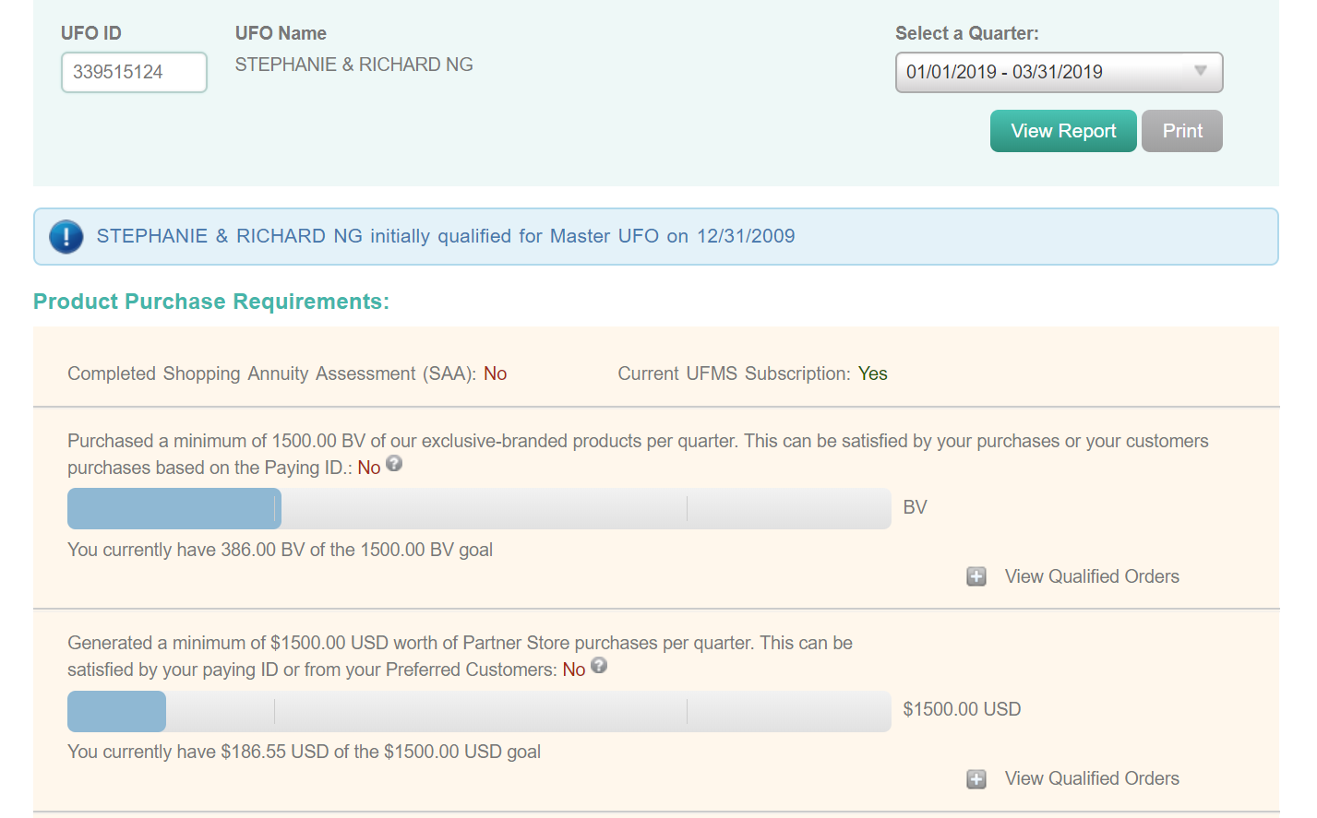

Slide 14
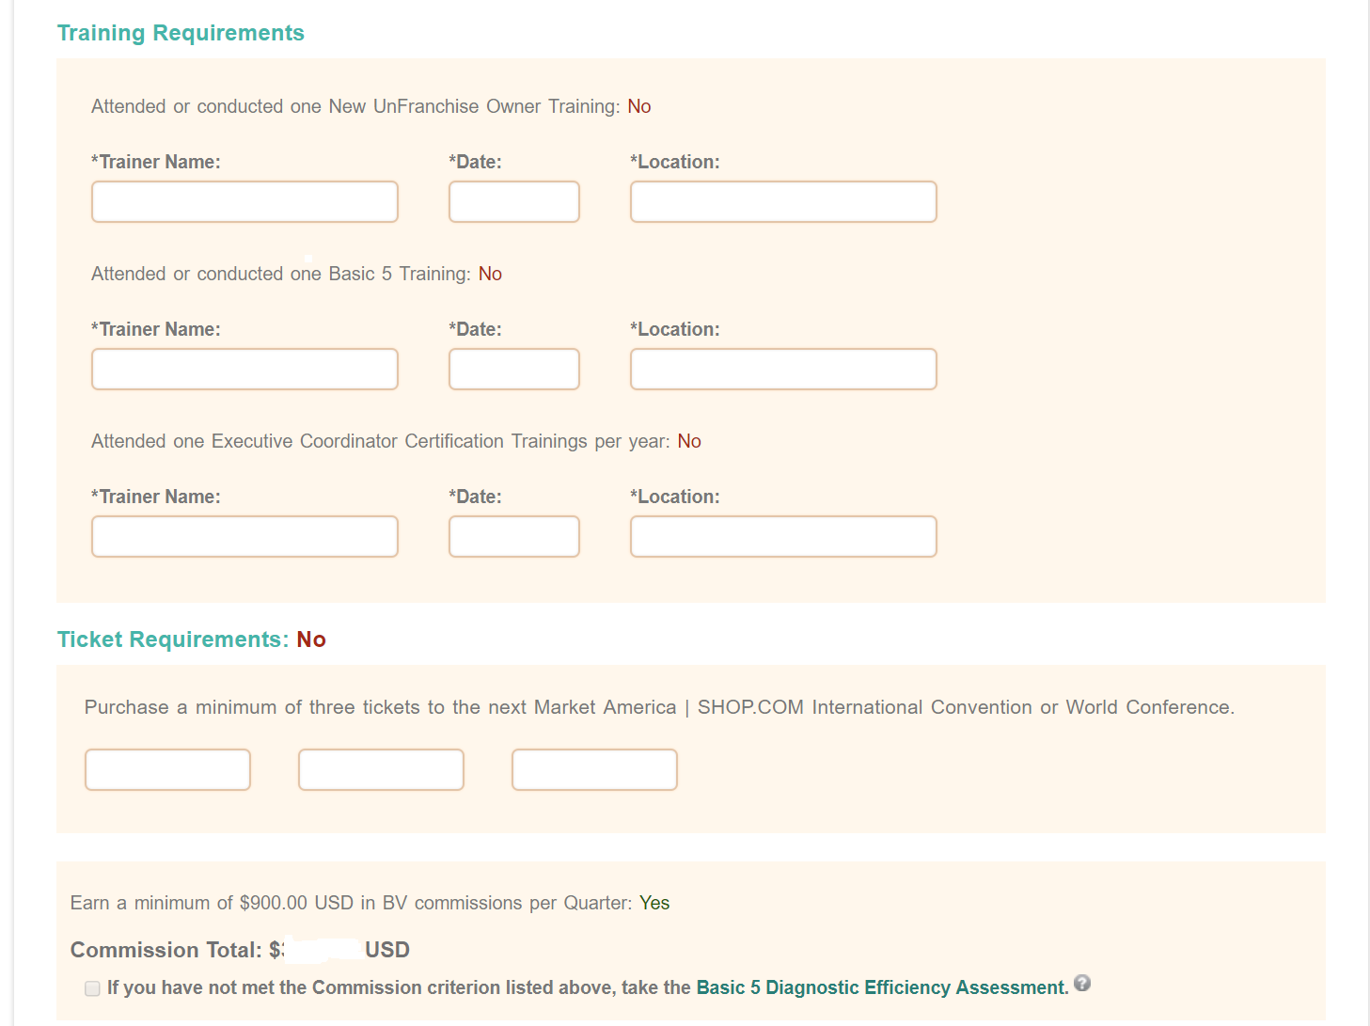

Slide 15
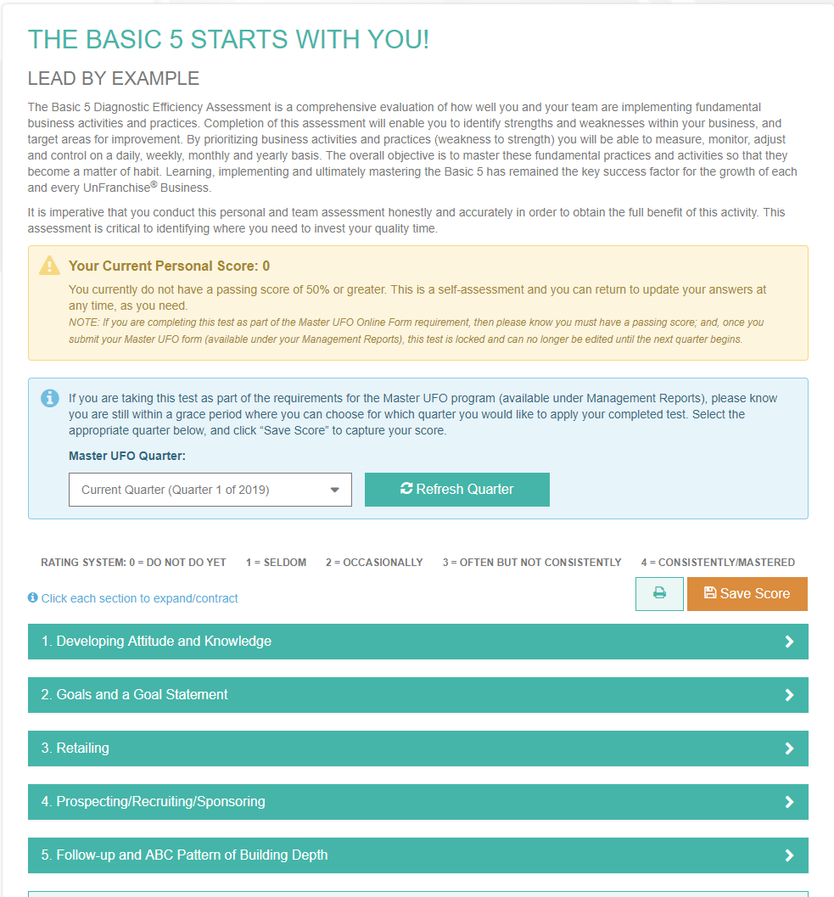

Slide 16
Key of Master UFO
1500 BV = 500 BV per mth
Sponsoring of one UFO per quarter

Slide 17
Quarter | Personal Sponsor | Team Sponsor | Total UFO | Total BV per mth | Commission Check / mth
1-2 qtrs | 1 |  | 1 | 500BV
3-4 qtrs End of 1st year | 1 | 2 | 4 | 2000BV | USD300
5-6 qtrs | 1 | 8 | 13 | 6500BV | USD1500
7-8 qtrs End of 2nd Year | 1 | 26 | 40 | 20,000BV | USD6000
9-10 qtrs. 2 ½ years | 1 | 80 | 121 | 60,500 (15,125BV / wk) | USD8400 for life

Slide 18
Master UFO Recognition
How to earn UFO Jacket Pin with Stone(s)
Qualify as a Master UFO by submitting your UFO Criteria Forms three out of four consecutive calendar quarter
**The exception is earning your very first stone. This can be done by qualifying three out of four consecutive quarters within a 12-month period. It does not have to be within the same calendar year.**
Upon earning a minimum of USD1500 per week 39 out of 52 weeks each calendar year (9.75months) you will be eligible to receive a Pin with one stone. Additional stones will be awarded on a yearly basis provided this minimum earnings criteria is met each year.
Your updated jacket pin will be sent to you automatically with the correct number of stones during the first quarter of the following calendar year.

Slide 19
Why Base 10 7 Strong?

Slide 20
What is Base 10, Seven Strong
Base 10 – 10 Customers using 1-2 products (40BV) = 400BV and Personally use = 200BV
Total = 500BV
1
1500 BV
1500 BV
500 BV
2
3
500 BV
500 BV
4
5
6
7
500 BV
500 BV
500 BV
500 BV
Earn > $300/Monthly (BV)
Notes:
20
20

Slide 21
Seven Strong
Notes:
21
21

Slide 22
Here’s what could happen in an organization with minimum focus on Retailing...
= $600 /month (BV)
YOU
Left
Right
50 x 50 BV
=2500 BV
50 x 50 BV
=2500 BV
Each Distributor does minimum 50 BV per month requirement
Notes:
22
22

Slide 23
Here’s what could happen when an organization focuses on retailing...
Left
YOU
Right
40 x 500 BV
=20,000 BV
40 x 500 BV
=20,000 BV
Same group – different philosophy regarding the power of retailing.
Each distributor has 10 customers using/purchasing 40 BV, and the distributor uses/purchases 100 BV = 500 BV/month
Notes:
23
23

Slide 24
Here’s what could happen...
YOU
Left
Right
$6,000 /month (BV)
40 x 500 BV
=20,000 BV
40 x 500 BV
=20,000 BV
Notes:
24
24

Slide 25
Just DO IT

